Slide 1

Green University of Bangladesh
Project name: Assistant of Traveler
Presented by:
Md. Hosain Rohman Noyon
---- 221902370

Slide 2
Outline
Introduction
Objectives
Advantages
Algorithm & Flowchart
Methodology
Limitations and Future work
Conclusion
02

Slide 3
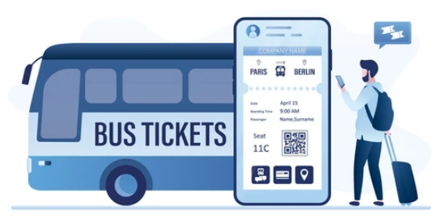
Introduction
An online Bus ticket buying system
A simple automated system
03

Slide 4
Objectives
To know the required bus name
To know the available bus path to reach destination
To buy bus ticket easily
To make admin manage the whole system easily
04

Slide 5

Advantages
Easy way to buy ticket
Easier management system
Can be used from anywhere
05

Slide 6
Algorithm
#start-> Display the home page showing:
i. Log In As Admin, ii. log in as User
Log In as USER:
1. Find Bus
2. Change Password
3. History of Buying Ticket
06

Slide 7
Algorithm
LOG IN AS USER
Find Bus:
1. Take the present and destination stoppage name
If present & destination is matched with any bus path,
-->Display the buses name
2. Take bus name and Go For Next Frame
3. Go Confirmation process
4. After being done payment process Display the ticket
5. Add Buying history to database
07

Slide 8
Algorithm
LOG IN AS USER
Change Password:
1. Take the current password and new password
If current password is matched with the user data,
--> Password may be changed in database
08

Slide 9
Algorithm
LOG IN AS USER
Show History of buying Tickets:
Connect to database
Match the Ticket buying data with logged in user name
If matched,
--> add object row to JTable
09

Slide 10
Algorithm
ADMIN Panel
1. Add New Bus Record
2. Update Bus Path & Cost
3. Delete Bus Path
4. Show Buying Ticket History
10

Slide 11
Algorithm
ADMIN Panel
Add Bus :
Read Bus Name, Cost, Stoppage Places, Distance from starting place
After clicking ‘Add’ button it will able to take more stoppage place and destination
After clicking ‘Confirm’ button the Bus records will be updated to database
11

Slide 12
Algorithm
ADMIN Panel
Update Bus Path:
Read Bus Name, Stoppage Places
If ‘Delete’ button is clicked →The stoppage name will be deleted from the Bus records.
If ‘Update’ button is clicked →the stoppage and destination will be replaced
12

Slide 13
Algorithm
ADMIN Panel
Update Bus Cost(/KM):
Read Bus Name, new Cost
If ‘bus name’ exists→The cost will be updated
Else ->show exception
13

Slide 14
Algorithm
ADMIN Panel
Show Ticket Buying Data:
Connect to database
Read data from the required table
Show the data to JTable
14

Slide 15

Methodology
Encapsulation
Exception Handling
Final, static keywords
String, Hashmap, if-else, loop
User-defined function
Built in packages
Swing
MySql Database
15

Slide 16

Limitations
Ticket printing problem
Inserting a stoppage problem
Online Payment system
Changing user data is not possible except password
16

Slide 17

Future Work
Create a process of ‘Inserting’ stoppages.
Connect online payment system
Create a system to change user data
17

Slide 18
Conclusion
Save time
User friendly
Easier management system
18

Slide 19
Any
Question
?

Slide 20
Thank You

